Slide 1
Ellon Academy
Primary 7 Parents Evening
Wed 15th June 2022

Slide 2
Ellon Academy
High expectations and aspiration for all learners
Skills development - Realising potential
Ready, Respectful, Safe
School Core Values
Personal Best

Slide 3
S1 Curriculum
Core:
PE, PSE and RME
Curricular Areas:
Business Education, Creative Arts, English, Humanities, Maths, Modern Languages, Technical
Curriculum Enhancement:
SEEDs, Creative Experience, Digital Skills
ASL:
Universal Support, Targeted Support, Community Resource Hub, Enhanced Provision

Slide 4
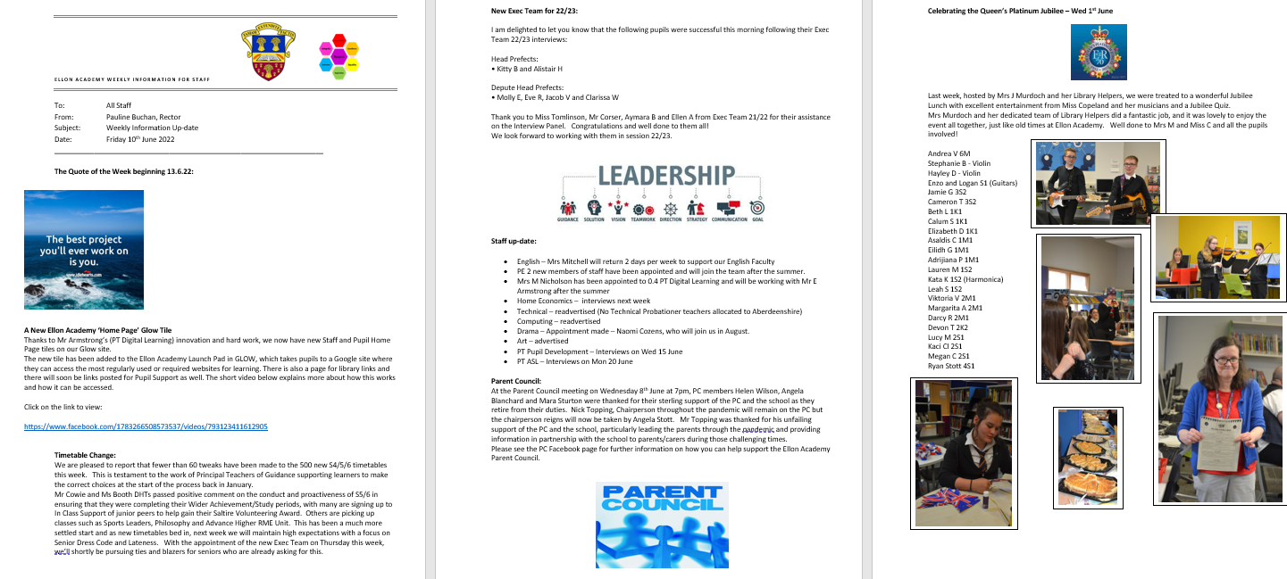
Communication:
Traditional – Text Messages, Letters
Weekly Newsletter for Parents/Carers
Phone calls – 01358 281150
Principal Teachers of Guidance
Social Media – School Facebook page
https://www.facebook.com/Ellon-Academy-Community-Campus-1783266508573537

Slide 5
Principal Teachers of Guidance
Cheyne House – Mrs P Waugh
paula.Waugh@aberdeenshire.gov.uk
Forbes House – Miss N Jeffrey
nicole.Jeffrey@aberdeenshire.gov.uk
Keith House – Mr K Findlay
kris.Findlay@aberdeenshire.gov.uk
McDonald House – Mrs C Kaczmarek
Claire.Kaczmarek@aberdeenshire.gov.uk
Sinclair House – Mon/Tues - Mrs L Donald Wed/Thurs/Fri – Ms M Watt
lindsey.donald@aberdeenshire.gov.uk may.watt@aberdeenshire.gov.uk

Slide 6
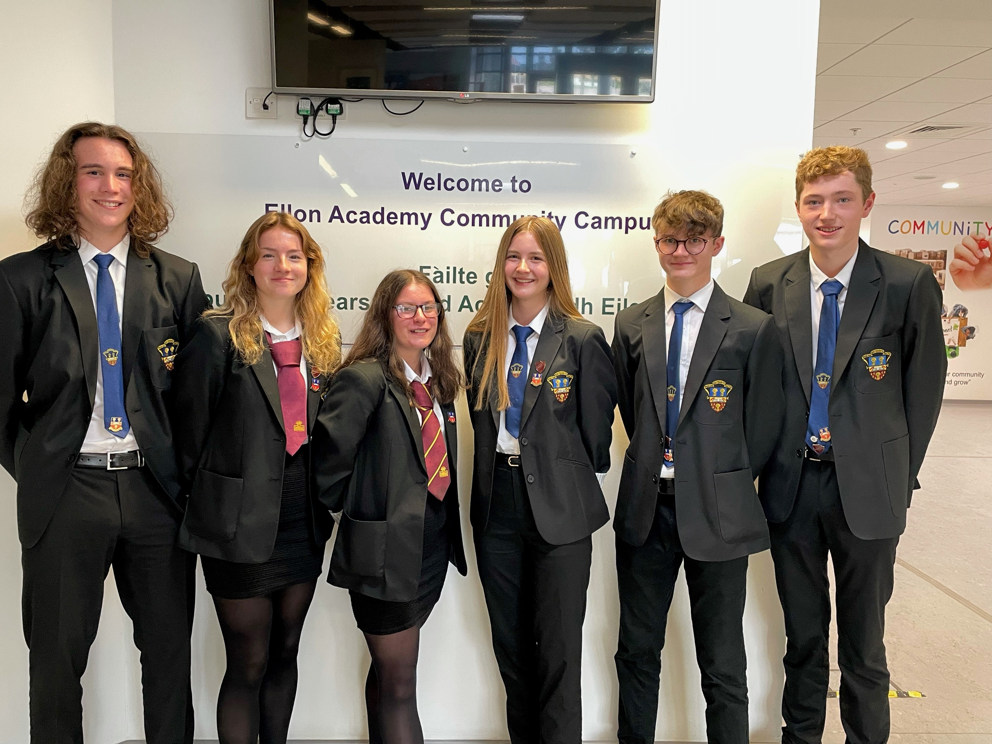
Parents/Carers – How You can Help?
School Uniform
Punctuality
School Bag/Essential Toolkit
Get involved:
‘What was the best thing about today’?
Parent Council

Slide 7
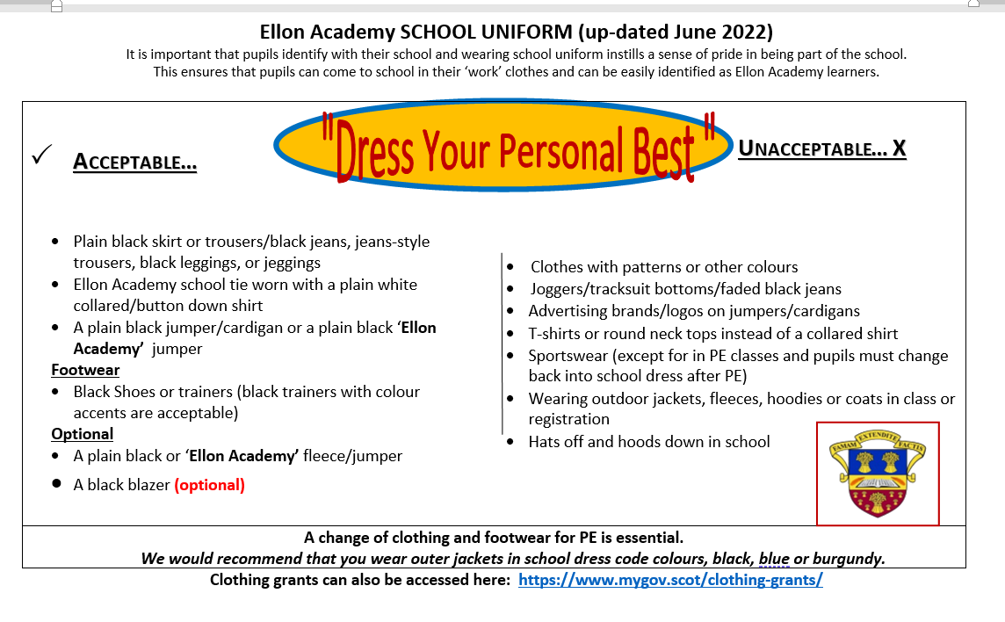

Slide 8
Thank you!
First day of Term 1 22/23 – Tuesday 23rd August
Personal Best

